Slide 1

Fall 2023 - STEM

Slide 2



Project Leader Introduction
Grant Flesher
Computer Science & Economics
Chesterton, Indiana
Henrique Raposo
Business Analytics & Economics
Rio de Janeiro, Brazil

Slide 3







Team Introduction
Avery Hsu
Biological Sciences
Austin, Texas
Tomas Londono
Chemical Engineering
Bogota, Colombia
Vince Smith
Finance
Fresno, California
Vicente Zavala
Pure Mathematics
Lima, Peru
Dan Huss
Computer Science
Pittsburgh, PA
Yohannes Mariam
Computer Science
Potomac, Maryland
Braeden Smith
Chemical Engineering
Frederick Maryland

Slide 4
Cardinal Health Introduction

Slide 5
1. Executive Overview
2. Targeting Tool
3. Commercialization Plan
4. Conclusion
5. Q&A
5

Slide 6




Executive Summary
Find new clients
Marketing
Audit
Goals
Develop a targeting tool that can be continuously updated with information
What publications and events should Cardinal Health be sponsoring
What top competitors are doing in the market
Targeting Tool
Commercialization Plan
- Provide ranking of companies that match ideal client criteria
- Easy to update, user-friendly, and interactive
-Competition analysis
-Physical marketing through events
-Digital marketing using articles, e-blasts and social media
Solution
Targeting Tool
Commercialization Plan
Next Steps
Team familiarizes with tool and how to update
Gain data of reach of the marketing
Test tool effectiveness compared to predetermined targets
Cost vs effectiveness

Slide 7
1. Executive Overview
2. Targeting Tool
3. Commercialization Plan
4. Conclusion
5. Q&A
7

Slide 8
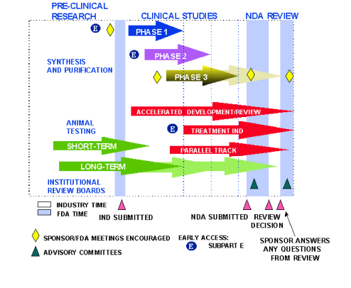


Goal: Identify Ideal Client
Company size
Product Phase and Area
Small, mid-size well-funded biopharmaceutical manufacturers
Pre-clinical to phase III products
Key focus: oncology, cell and gene (typically both well-funded)
Based on Market Cap
Small <= $500M
Medium = $500M to $2B
Large > $2B
Based on Employees
Small: <1,000
Medium: 1,000-10,000
Large: >10,000

Slide 9

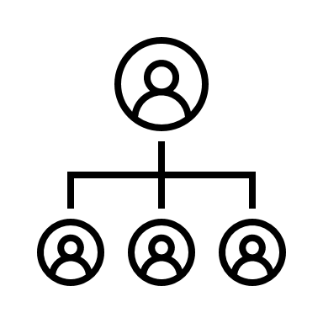


How the tool works?
Data Acquisition
Ranking System
Backend
Frontend
Original data sourced from CDC on 10/31
New data can be easily uploaded, and tool will update
Scores products by how compatible with CH's regulatory services
Drug rating on 100-point scale Company rating based on drug ratings and company size
Data stored locally
Information for Market Capitalization scraped from Yahoo Finance
Filters are easy to apply and Intuitive
Interactive and responds dynamically to filters
Products presented by drug rating in descending order

Slide 10
Prototype Demo

Slide 11
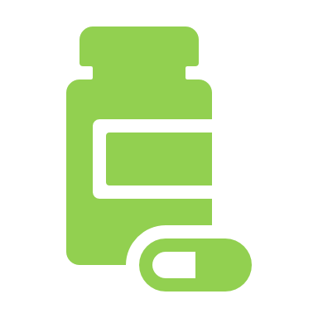





Assumptions & Constraints
Assumption 1
Assumption 2
Assumption 3
Inclusion of additional unrequested criteria to improve ranking effectiveness
Includes MoA Approval and Proprietary level
​If company is privately owned and not listed in the stock market, we assume that the company is either small or mid-sized
The data from CDC is complete and has no missing values for company, product, category and phase
Assumptions
Constraint 1
Needs to be online in-order-to run properly
Result of web-scraping for company data
Does not display company contact information
Requires use of separate program Zymewire
High number of drugs results in high saturation of similar rankings
Results in occasional negligible difference between drug rankings
Constraint 2
Constraint 3
Constraints

Slide 12
1. Executive Overview
2. Targeting Tool
3. Commercialization Plan
4. Conclusion
5. Q&A
12

Slide 13















Competition Analysis
Marketing
Social Media Platforms
Why Market?
Labcorp
Labcorp IQVIA
Customer awareness about services
Online presence through websites
Direct customer advertising
Patient app for accessibility
Multiple social media presence
Positive economic impact and growth
Brand reputation management
Events
IQVIA
Cardinal Health
Labcorp
IQVIA
One upcoming event posted; J.P. Morgan 42nd Annual Healthcare Conference
Webinars for customer engagement
Online presence
Various social media platforms
Data usage for marketing
Webinars with speakers; mental resilience event
Lots of webinars; many events like AI in healthcare and MedTech conference
Cardinal Health has many competitors in the biopharmaceutical department and each competitor like Labcorp and IQVIA has their unique ways to target customers.
Source: Labcorp, IQVIA, Cardinal Health
13
Notes:
Patient app is for laboratory results and notification – can be used for regulatory purposes

Slide 14









Medium sized company Events
Vertex Pharmaceuticals
Biomarin Pharmaceuticals
Biotech company (1989), Boston HQ
Innovative medicine development
Ongoing studies for small molecule medicines
Approved therapies for Cystic Fibrosis
Approximately 4800 employees
Biotech company (1997), San Rafael HQ
Global leader in enzyme substitution and gene therapies for rare genetic diseases
Offices across the nation
Approximately 2600 employees
Technical and Cyber
What events are they attending?
Both companies hold conference calls every quarter.
They pitch their advancements to other companies and seek investors
Baird’s 2023 annual Global Healthcare Conference
Unites investors with senior management, 90+ companies. Event is invitation-only,
SVB Securities Global Biopharma Conference
SVB partners with innovative healthcare companies to shape the future
Guggenheim’s Genomic Medicines and Rare Disease Days
- J.P Morgan healthcare conference
- TD Cowen healthcare conference
- Goldman Sachs healthcare conference
Medium sized events are crucial for CHRS for expand into smaller, midsize pharma companies and increase their number of net new clients. These companies and the events they attend offer a platform for business development and strategic growth within the healthcare industry.

Slide 15



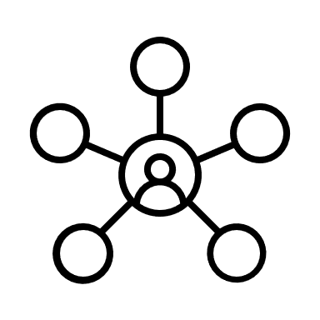


Bio International Convention
Bio International Convention
Why should Cardinal Health attend?
Hosted by Biotechnology Innovation Organization
One of the largest biotechnology conference globally
Enriches industry with networking and partnering
BIO one-on-one partnering
Engaging programming in areas like regulation and policy outlook
Technical and Cyber
Other Events from BIO
Benefits and Limitations
Statistics
Benefits
Withdraws
Application
Bio International Convention
20,000 + registrants
47 states and 73 countries
57,000 partnering meetings
Diverse range of professionals
Only one Cardinal Health registration in 2023
Invest in more attendance
Increase number of panels and meetings
Small startups attend
Networking and visibility
Showcase of regulatory services
Panels and presentations
4 day event
Very large
Competition attendance
Variety of fields featured
Cost
Time commitment
Lots of information
Bio Investor Forum
Bio Partnering
Cardinal Health can utilize Bio International Convention to commercialize its regulatory services to small, pre-clinical companies. The convention is very large, diverse, and allows companies to showcase their services. And
Sources: BIO
Notes:
Avery Pass to Vicente
Bio International Convention
Big size of the convention
attractions to smaller companies
less selective and smaller companies are able to attend
bigger size of convention= smaller cost for smaller companies to attend = increased chance of smaller companies to attend
the diverse set of companies that attend provide many opportunities for CH to take advantage of in terms of partnering
diverse= very likely that smaller companies can attend
popular location ie San Francisco= attraction for companies for regulatory services and potential investors
Cardinal Health
can promote their regulatory services and showcase their services through panels in order to find their key target companies
to attract smaller companies CH can sent employees to browse the set of companies and schedule meetings for one on one communication

Slide 16




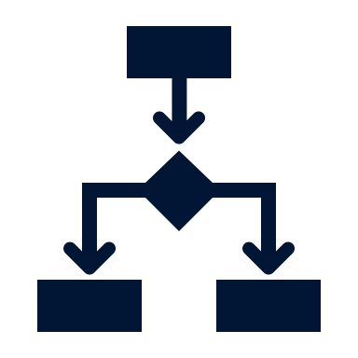
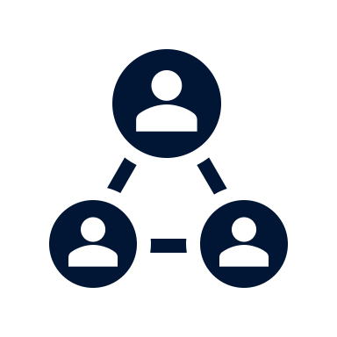




Social Media
k
Wide Reach:
- Vast user base = ideal medium to reach a broad and diverse audience.
- Good for biopharmaceutical companies looking to engage with other businesses, healthcare professionals, researchers, and collaborators.
Content Sharing:
- Sharing valuable content
- Research findings, clinical trial updates, industry news, and educational resources.
- Position them as thought leaders in their field attracting attention of other companies.
WHY?
Targeted Advertising:
- Offer highly sophisticated targeting options.
- Can tailor their advertising efforts to specific industries, job titles, interests, and demographics.
- Ensures content reaches relevant audience.
Engagement and Interaction:
- Two-way communication.
- Engaging with target audience
- Helps build relationships, trust, and credibility, and highlights possible areas for improvement
Social media is a powerful technique for companies, including biopharmaceutical companies. Social media offers biopharmaceutical companies a diverse set of platforms to connect with other businesses, share valuable content, and increase their industry recognition. Choice of platform should align with company's goals and target audience, allowing them to effectively engage with the right partners and stakeholders.

Slide 17
Social Media Strategy - Instagram
Increase number of clients for Cardinal Health Regulatory Sciences by finding ways to create a successful social media platform that reaches smaller and midsize pharma companies.
Upload
Influence
Posts – Memes, polls, advancements
Shorts – Partnerships, sponsorships, campaigns
Connect with our market through our nation’s most successful connectors – INFLUENCERS
Amy Harmon
Advertise
Follow
Digital ads - Target specific demographics, reach target audience, interact with customers/prospects, everything on their favorite social media platform -> ASSOCIATION
Get involved. Follow other companies,
Connect with other institution e.g. universities Handshake.
Develop
Act
Plan social media image
Invest into applying the suggested solutions
Design, test run, and advance the vision
Maintain and update new features

Slide 18
Instagram Account Plan
Timeline
Set up business account:
-Bio with website link
-Concise username
Post account on other social media:
-Facebook, Twitter, LinkedIn, YouTube
Apply for verification:
-Enhances credibility
-Increases following
Creation
Maintenance
Consolidation
Make 5 posts immediately:
-Makes page look official and active
-Gains traction
Post once per day:
-Consistency is key
-Professional looking content
Account Post Ideas
Benefits of Account
New medical product showcases with benefits and uses
Health tips to promote general well-being
Healthcare industry news
Increases brand visibility
Allows customers to directly communicate with the Cardinal Health
Increases marketing opportunities

Slide 19
Social Media Financial Aspect
Subdivided Costs
Digital advertisements
Around $500 minimum with $5 per thousand views
Social media team salaries and cost
Around $65,000/year
Influencers
Around $2,500/post of “Mega-Influencers”
Sponsorships
Depends on the sponsored entity. Expect to spend around $5,000
Becoming verified (Blue check mark)
Some platforms like X, formerly known as Twitter, charge $8 monthly for this, and some don’t charge but require strong social media engagement which has an implicit cost
Preliminary estimated total cost
$100,000–$400,000 Yearly
A social media marketing campaign encompasses various hidden costs such as the cost for a social media marketing team, the varying cost per post charged by influencers, the diverse sponsorable communities, and more.
Sources: ZipRecruiter, K6Agency, EmbedSocial

Slide 20
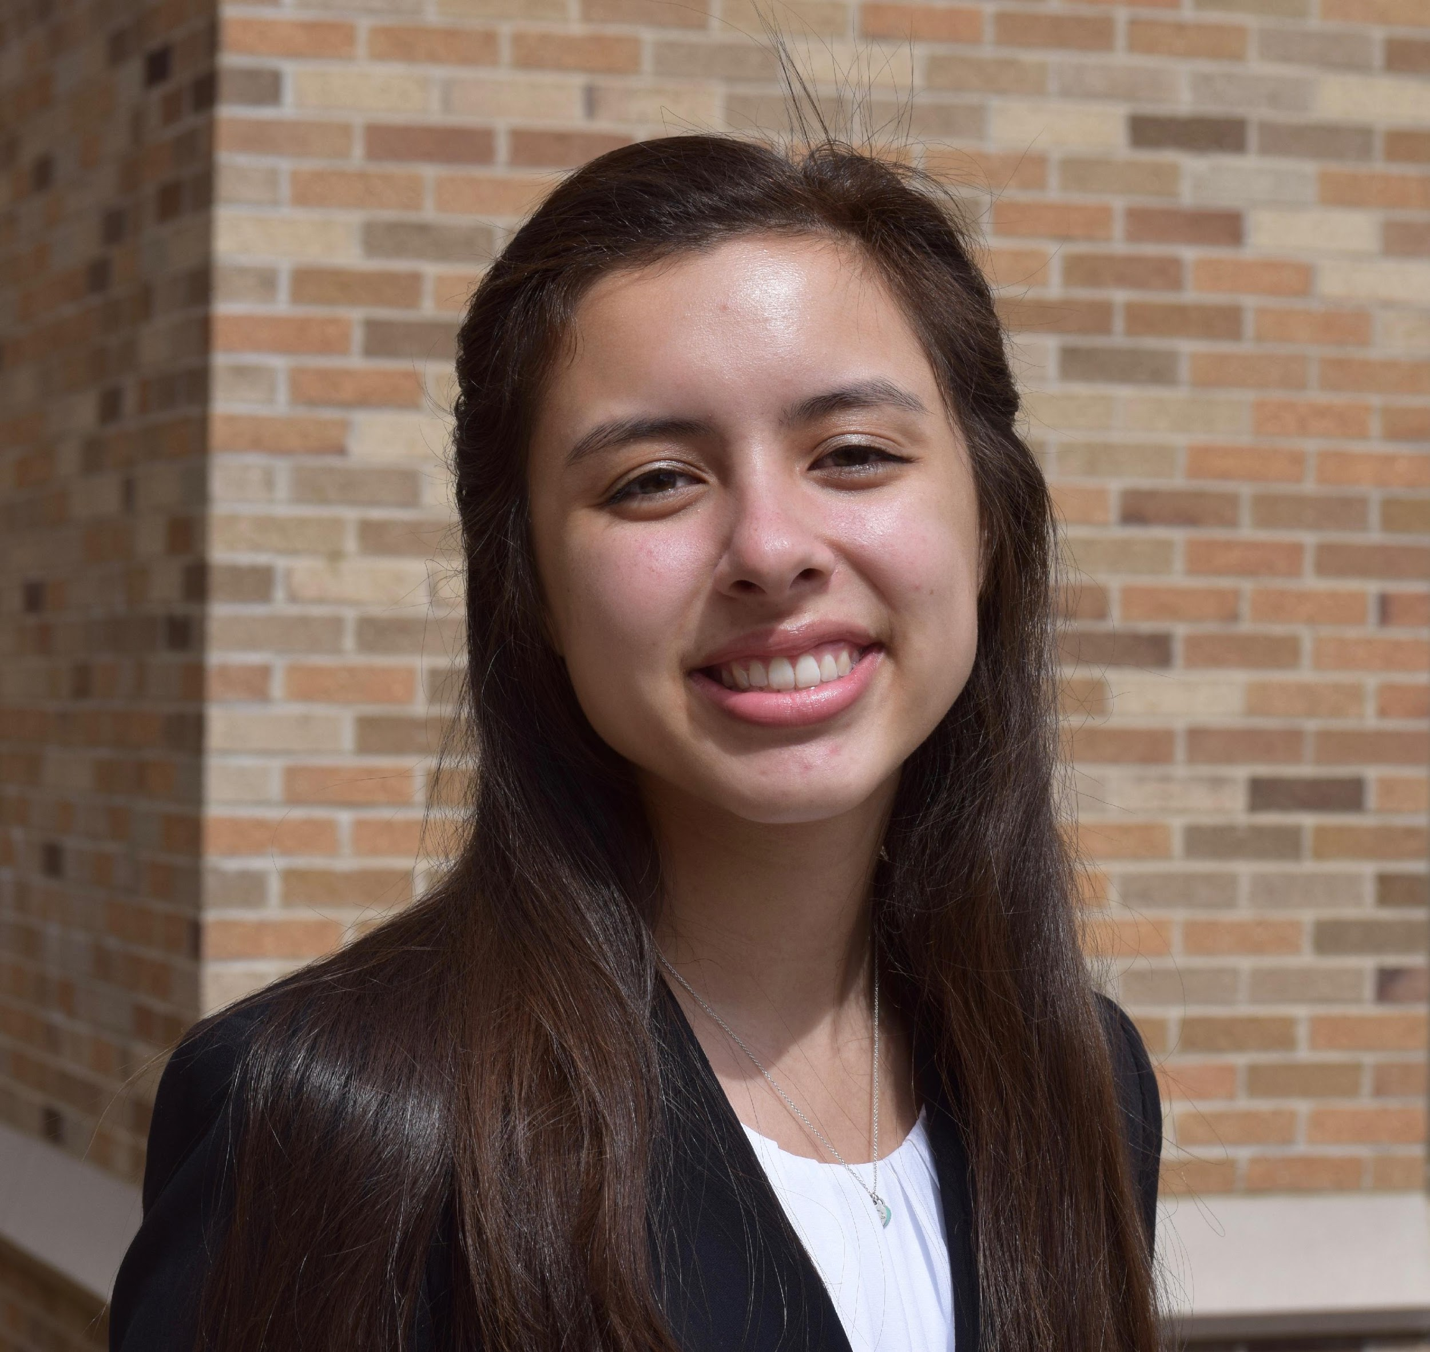
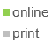



Article & E-blasts
Use of Newspaper Articles
Use of E-Blasts
Current Overview
Current Overview
No current use of physical newspaper articles
Online platforms such as CISION (PR Newswire)
Website has access to information
Clients may sign up for E-Blasts through the website
They must click the option to sign up
Regulatory Services
Regulatory Services
No online article commercialization
No newspaper commercialization
Online website has most promotional information
Drug Development and Regulatory Consulting permission to communicate E-Blast
Must click the “Permission to Communicate"
Are Newspaper Articles Effective?
Are E-Blasts Effective?
Overall: No
Overall: Yes
Regulatory services are a small niche environment
Newspaper publishing revenue is decreasing
Regulatory services are a small niche environment
Email marketing provides easy access to targets
Commercialization for regulatory services is not effective through newspaper articles and online articles as the revenue is slowly decreasing with time. The use of E-Blasts is effective as regulatory services are a niche environment and target audiences have easy and effective access to information through E-Blast.
Sources: Statista
Notes:
Avery

Slide 21


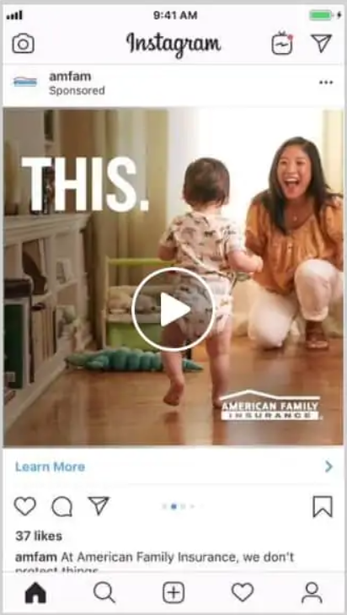






Implementation
Addition of Articles and E-blast
Implementation Mock Up
Ensure that additional information of the regulatory service is explicitly stated
Target audience is able receive updated information
Consumers are able to make informed decisions as it is low stakes and pressure
cardinalhealth
Sponsored
Cardinal Health’s verified username and sponsor for the ad is displayed
A video ad is played giving information about Cardinal Health regulatory services
Overview of implementation
User is presented with a social media ad
They can press “learn more” through an article
User is able to sign up for e-blasts by clicking a button
Presented with a short information gathering and are subscribers
Users can press “learn more” for an instant article pop up with more detailed information
cardinalhealth Customers can enjoy regulatory services
A caption can be added with a link to sign up for subscriber e-blasts
Customers can receive information about Cardinal Health's regulatory resources through eblasts and articles. Cardinal Health can implement eblasts and articles into their Instagram social media.
Sources: CardinalHealth, Instagram
Notes:
Avery
Pass it to Dan

Slide 22
1. Executive Overview
2. Targeting Tool
3. Commercialization Plan
4. Conclusion
5. Q&A
22

Slide 23
Risks and Mitigations
Risks
Mitigations
Next Steps
New Targeting Tool
Targeting Tool Training
Develop a training plan and schedule training sessions to ensure proficiency of the tool
Employees are unfamiliar with the new tool and how to utilize it.
Initiate workshops and hands-on training to teach the application of the tool.
Inaccurate Data Analysis
Regular Accuracy Checks
Set a timeline to test the accuracy and reliability of the targeting tool
Incorrect analysis from the tool could affect business decisions
Schedule routine checks to verify accuracy of the tool's output.
Untargeted E-blasts
Optimize E-blasts
Conduct surveys to understand the reception of E-blasts and improve communication
Emails sent out may not be effectively personalized or fail to engage recipients
Implement email optimization strategies to enhance engagement.
Inefficient Use of Social Media
Social Media Strategy
Ineffective outreach and engagement or miscommunication through social platforms
Continually optimize the social media strategy based on performance insights for effective engagement
Perform regular analyses of social media engagement to adjust strategy

Slide 24
Conclusion
Goals
Solutions
Pharmaceutical Targets
Targeting Tool
Find ideal smaller, mid-size pharmaceutical targets
create a plan to reach these targets
Sorts through thousands of drugs and companies
Apply a ranking system to find ideal clients that meet specified criteria
User friendly interactive interface
Optimal Client Identifier
Goal
Develop a targeting tool that updates with information on the pharmaceutical pipeline
Used by our business development team to find new clients
Commercialization Plan
Analyze strategies of top competitors
Plan and attend events to meet new clients
Create a social media strategy to extend outreach
Utilize e-blasts to effectively give clients information
Client Acquisition Strategy
Goal
propose a commercialization plan to target ideal clients
Discover what top competitors are doing in the market to reach clients

Slide 25
1. Executive Overview
2. Targeting Tool
3. Commercialization Plan
4. Conclusion
5. Q&A
25

